Slide 1
Move to Toronto or NYC?
M Gutierrez

Slide 2
Intro
I have a job offer in both Toronto and NYC.
Based on public data on neighborhoods, venues, crime, and housing prices, I will make a choice where to go.

Slide 3
Data
To compare the 2 cities, I need to use geographic data from each city that include neighborhoods names, crime data, housing data, and venues data. The venue data is collected from Foursquare.
Geographic data sources:
New York City (JSON): https://cocl.us/new_york_dataset
Toronto: https://en.wikipedia.org/w/index.php?title=List_of_postal_codes_of_Canada:_M&oldid=945633050
Housing Data Sources:
New York City: http://www.city-data.com/zipmaps/New-York-New-York.html
Toronto: https://www.kaggle.com/mnabaee/ontarioproperties
Crime Data sources:
New York City: https://data.cityofnewyork.us/Public-Safety/NYC-crime/qb7u-rbmr
New York City GeoJSON: https://raw.githubusercontent.com/dwillis/nyc-maps/master/police_precincts.geojson
Toronto: https://data.torontopolice.on.ca/
Toronto GeoJSON: https://raw.githubusercontent.com/jasonicarter/toronto-geojson/master/toronto_crs84.geojson

Slide 4
Data Cleaning
I will make sure to doing a filtering of the data to ensure that none existent values are omitted, and that data like housing and crime are comparable between cities. I will be comparing the most recent complete year of data.

Slide 5
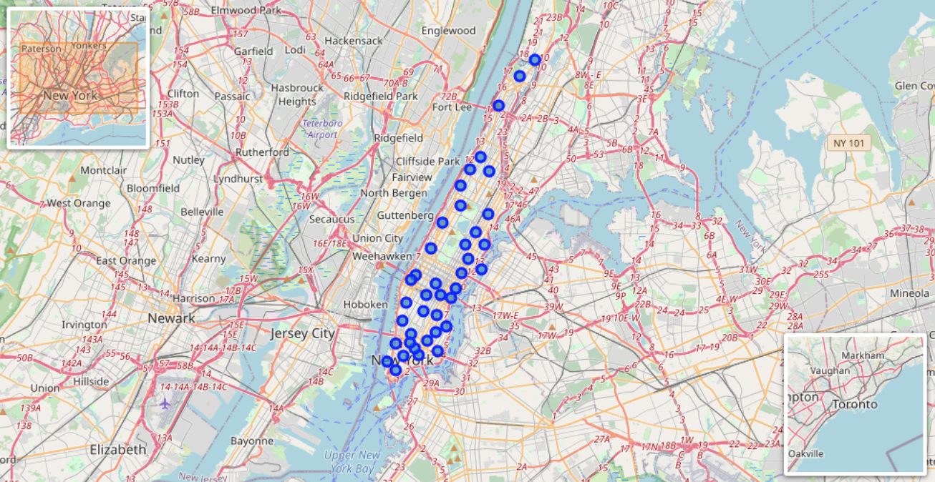
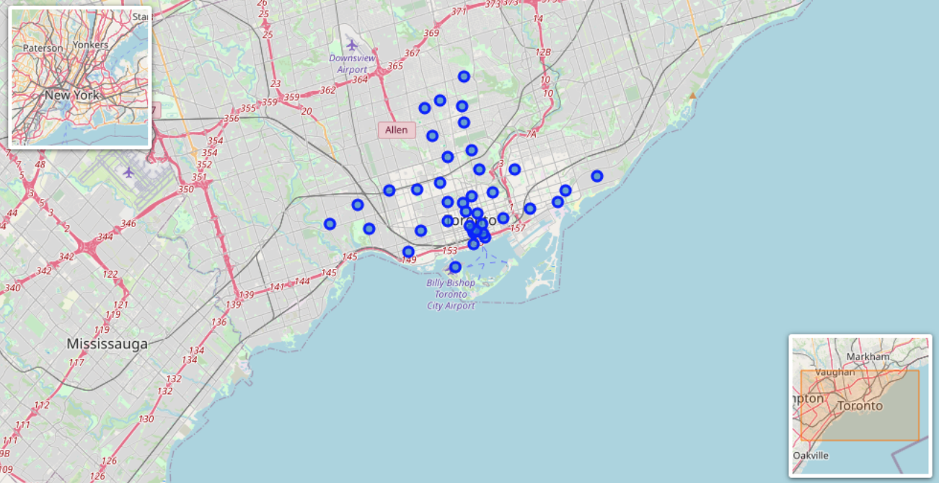
Hood Maps
NYC = 40 Toronto = 39

Slide 6
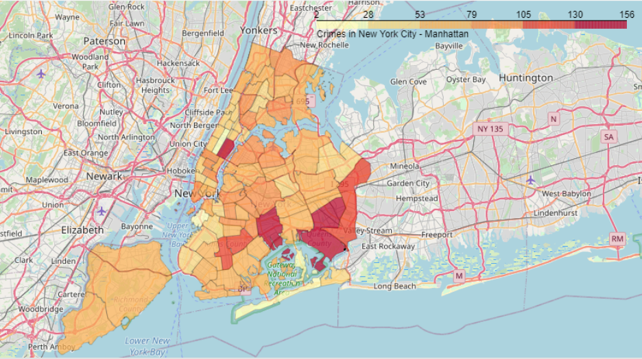
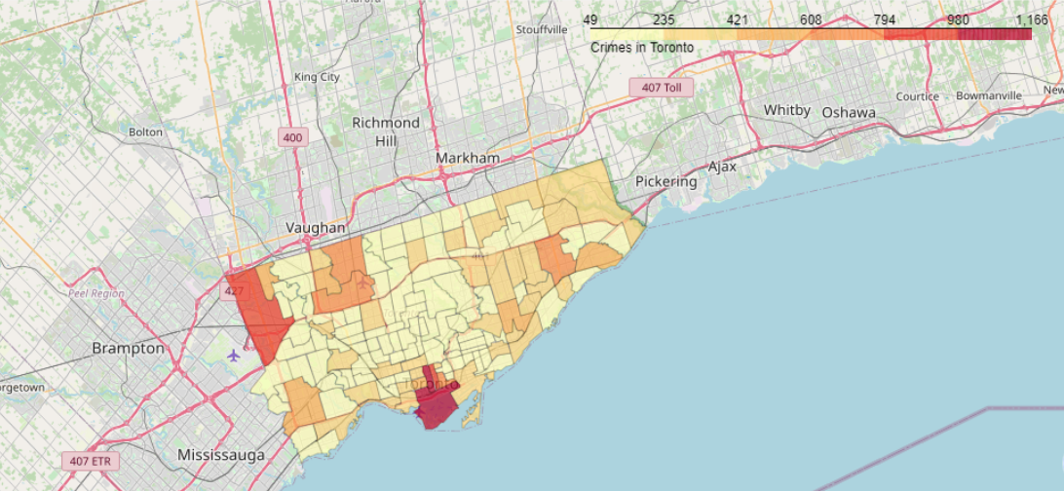
Crime Heat Maps
Red = High, Orange = Mod, Yellow = Low
NYC Toronto

Slide 7
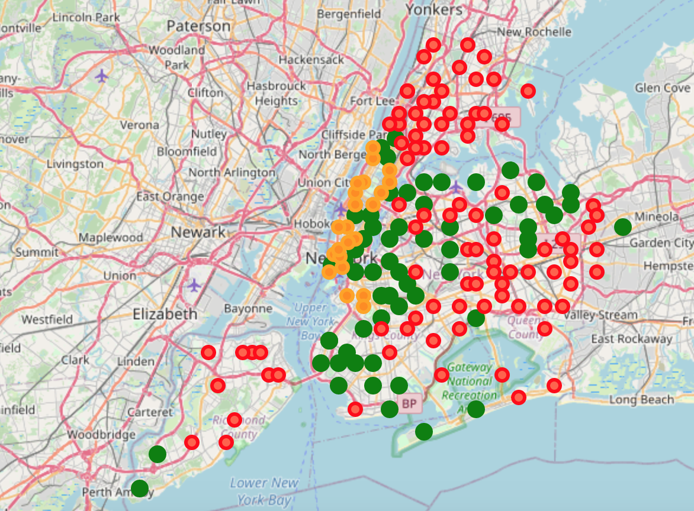
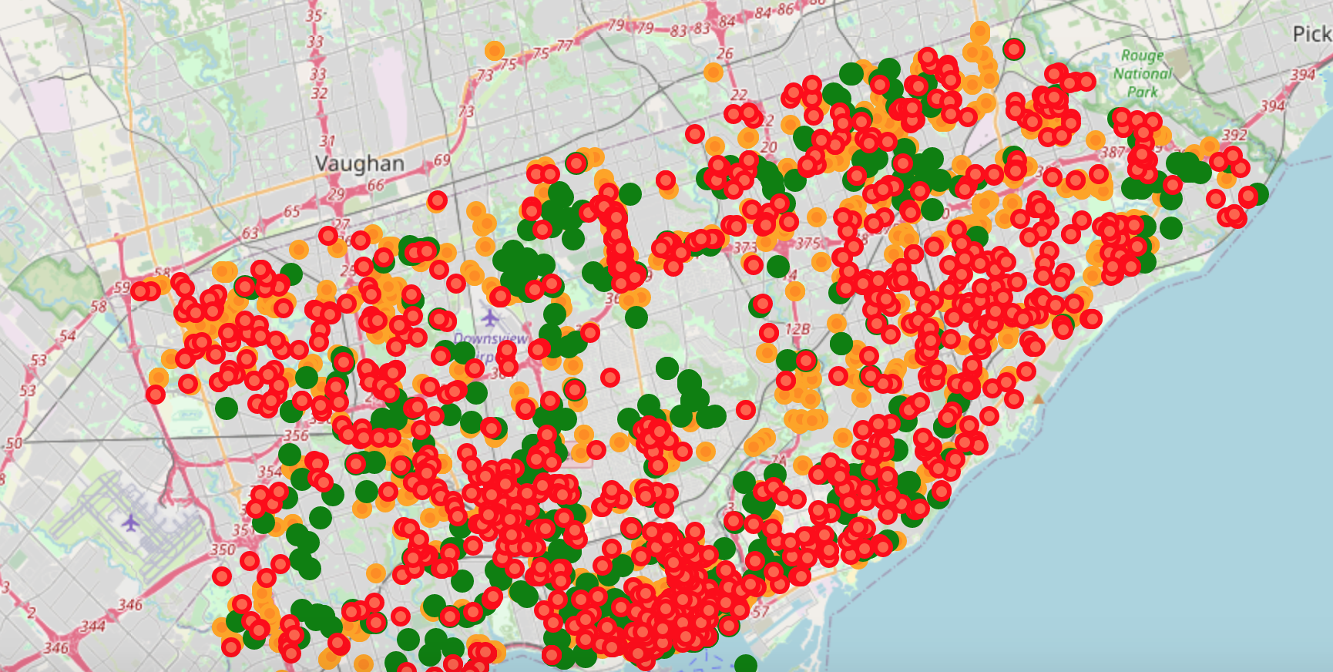
Housing Prices
Red = High, Orange = Mod, Green = Low
NYC Toronto

Slide 8
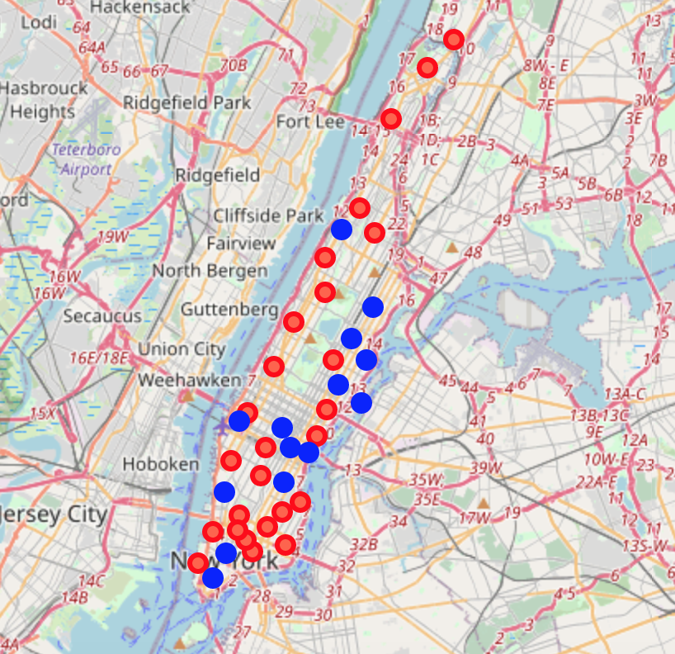
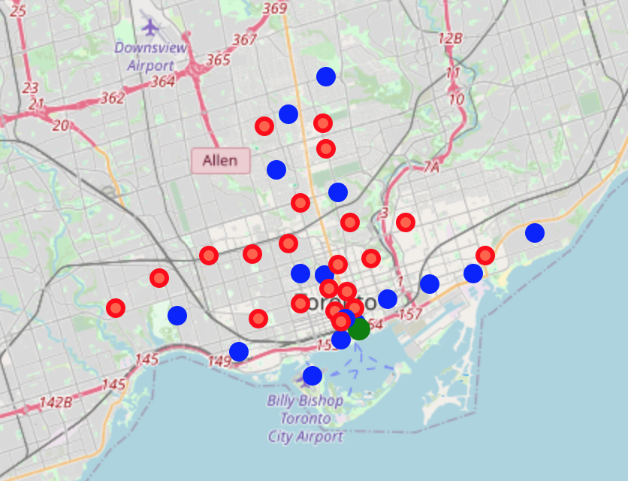
Venue Data
Red = Inside Entertainment, Blue = Outdoor Space
NYC Toronto

Slide 9
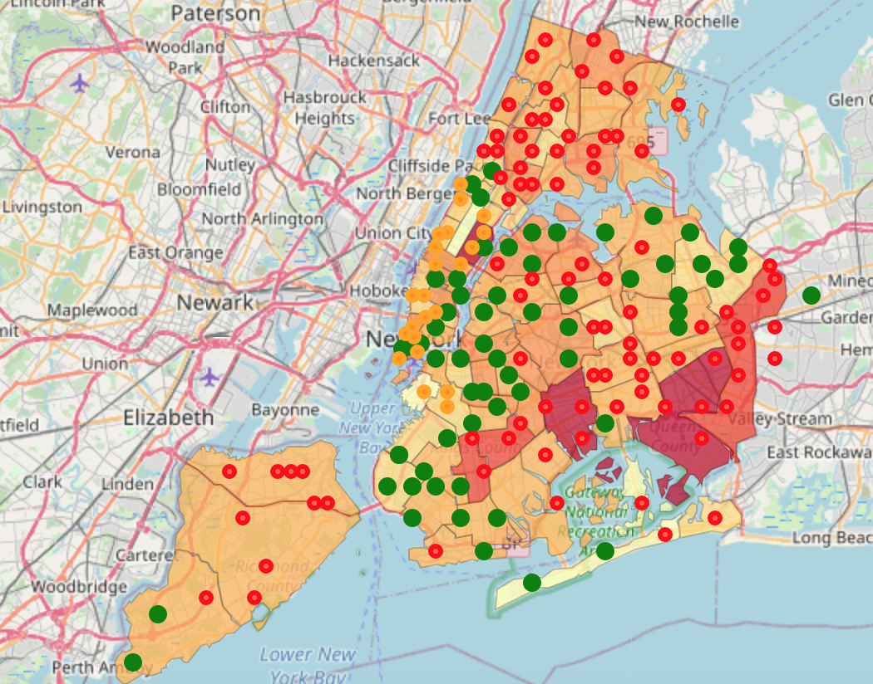
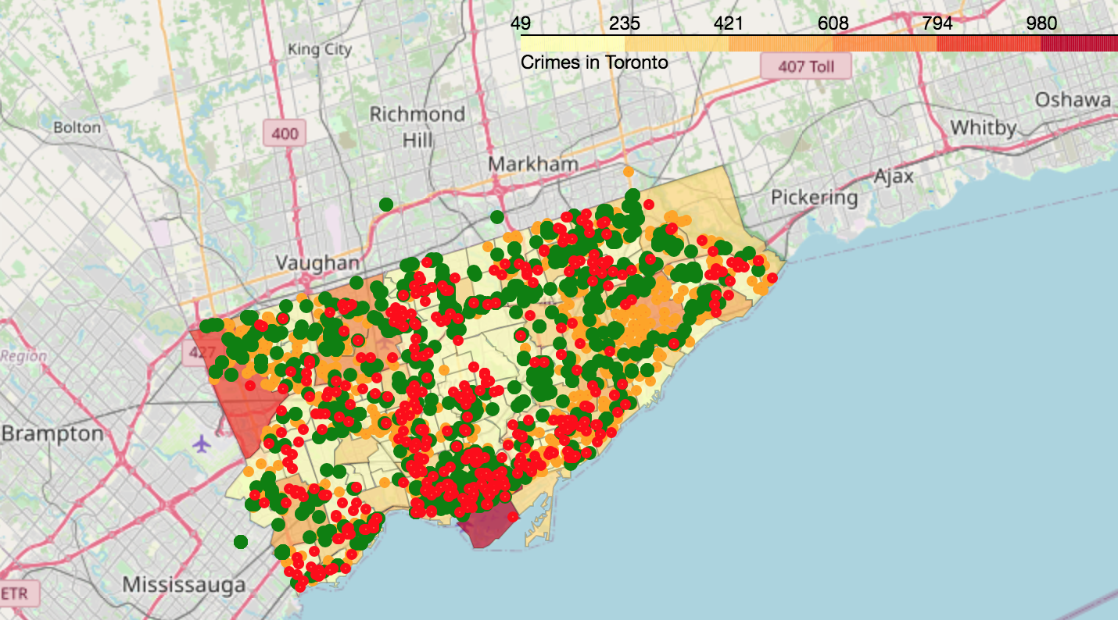
Livability Maps
NYC Toronto

Slide 10
Conclusions
NYC has more crime and higher housing prices…
Venues are bascially the same
I will move to Toronto to hang out with Drake ☺

